Slide 1
Communicating without words
.

Slide 2
Communication without words
The clip you are about to see is of Evan (4 months) and his Mum playing.
This video will help you think about how children communicate before they can talk and the strategies that adults can use to help develop communication whatever the age of the child.

Slide 3
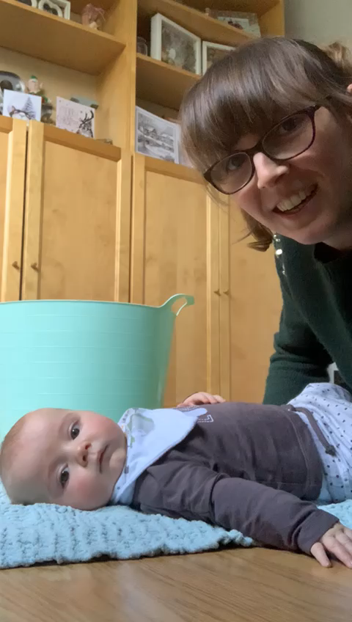
Click the play button under the image to view the video

Slide 4
Did you notice...
Evan moving his body and looking at his mum – this is his way of “talking” to mum
Mum uses one word at a time with the objects and a gesture (this means using our hands)
Mum repeated the words several times
Mum paused after “ready, steady…” to allow Evan time to respond
Mum used hand over hand to help him join in

Slide 5
Watch again..
Watch the video again and look out for the above.
What else did Evan do and how did Mum respond to this?

Slide 6
Watch again..

Slide 7
Did you notice..
Evan vocalised (this means make a noise).
In response to this, Mum interpreted his sound as communication and named the word for him.

Slide 8
How can I use this in real life?
Think about all the opportunities across your day that you can communicate with your child. This can be in play or in simple everyday activities such as:
Talking about the size/colour/shape/feel of something
Naming animals at the farm
Talking about a vehicle, bird or animal you have seen
Naming the things you are buying in a shop
Singing action songs
Naming the actions you are doing (cleaning, waving, driving, eating)
Talking about the pictures in a book

